Slide 1
An Analysis of the NBA
By Team CJ

Slide 2
Project Data Description and Project Aim
Data Description:
The salaries of NBA players data were scraped from the ESPN website, while their in-game statistics and team win records were scraped from basketball-reference.com
Project Aim:
To get a deeper understanding into the game of basketball to see how players perform on the court, the factors affecting their salary and an overall team's performance.

Slide 3
Data Cleaning
Removing special characters from team names in the team wins data.
E.g. team$Team <- gsub("\\*.*","", team$Team)
Removing special characters from the salaries data and separating player positions from their names.
Importing team names for players with missing teams.
E.g. stats %>% filter(is.na(TEAM)) %>% select (Player, Tm, TEAM, SALARY)
Scraping the current NBA player roster and merging the team name data with our dataset.

Slide 4
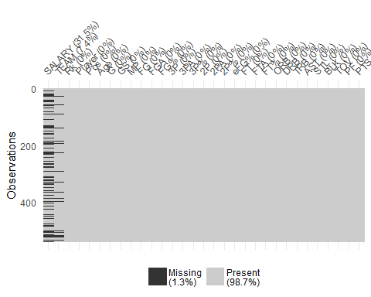
Dealing with missing data
In order to be able to make complete analysis, we will need to have a strategy to handle our missing data.
Missingness map
Feature 1
Feature 2
Feature 3
Here, we can see that only 7.4% of players are missing a team.
As we have already copied the information over from the current NBA roster, we can assume that these missing players are no longer currently playing in the NBA, so we can drop these.

Slide 5
Dealing with missing data
In order to be able to make complete analysis, we will need to have a strategy to handle our missing data.
What proportion of our players have a missing salary?
However, there are still 26% of our player observations who are missing a salary value, which is high. We will therefore build a linear model later on to generate the missing salary values.
stats <- stats %>% filter(!is.na(TEAM))
stats_miss <- miss_summary(as.data.table(stats$SALARY))
stats_miss$miss_df_prop

Slide 6
Questions
Does a player's salary translate into how well they perform?
Can we model the salary for those players with missing values using the existing salaries?
Which type of stats do each respective positions normally achieve?
Does the amount that teams spend on player salaries translate into their win records?

Slide 7
Modelling Salary
Examining the relationship between the variables and salary
## var intercept slope r2 ## 1 PTS 2472729 8831.803 0.30644869 ## 2 AST 4127921 27699.451 0.22654032 ## 3 STL 3635001 96809.924 0.17722083 ## 4 BLK 5179952 92777.673 0.12797298 ## 5 TRB 3628330 16640.187 0.19926503 ## 6 Pos 6405815 1519271.688 0.01699339 ## 7 Age -9534656 653080.387 0.12692602 ## 8 GS 3377062 148854.380 0.32488740 ## 9 MP 1926684 4390.718 0.22674760
From here, we can see that some of the single variables that best explain the variation in salary are their games started, points and minutes played which explain 32%, 31% and 23% of the salary variation respectively, which is more of what we expect since some of the main statistics that players' values are analysed by are these.

Slide 8
Modelling Salary
Building our model
mod1 <- lm(data = stats, SALARY ~ PTS+GS)
mod2 <- lm(data=stats, SALARY ~PTS*GS)
mod3 <- lm(data=stats, SALARY ~PTS*GS*MP)
mod4 <- lm(data=stats, SALARY ~ PTS*MP*GS+Age*PTS)
## r.squared adj.r.squared sigma statistic p.value df logLik ## 1 0.522898 0.5109705 5367842 43.83952 1.044334e-52 10 -6253.435 ## AIC BIC deviance df.residual ## 1 12528.87 12571.92 1.037294e+16 360
From the above, we began with points and games started and found that the interaction between them gave us a slightly higher R2 value. We then added another interaction with the minutes that the players play, which increased it by another 2%. We then include age, as well as another interaction with points, which increases the R2 significantly by 13% to 52%.

Slide 9
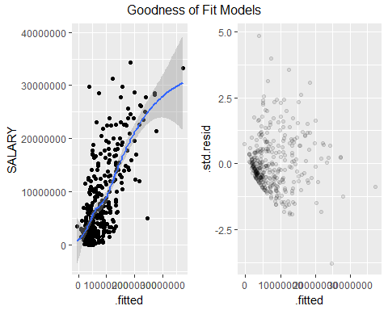
Modelling Salary
Salary = -2790279.92 - 9058.61*PTS - 1096.57*MP + 242468.38*Age + 117186.18*GS - 3.21*PTS*MP + 640.53*PTS*Age + 65.34*PTS*GS + 0.039*PTS*MP*GS - 54.65*MP*GS
Here, there appears to be a somewhat linear relationship between the observed and fitted values, although still quite a lot of variance, as the model could still be stronger. There also does not appear to be any discernible relationship within the residual plots, suggesting that the model is sound.

Slide 10
Modelling Salary
Imputing the modelled salary values back into our dataset
impute_ model<- function(PTS, MP, GS, Age) {
salary <- -2790279.92 - 9058.61*PTS - 1096.57*MP + 242468.38*Age + 117186.18*GS - 3.21*PTS*MP + 640.53*PTS*Age + 65.34*PTS*GS + 0.039*PTS*MP*GS - 54.65*MP*GS
return(salary)}
stats <- stats %>%
mutate(SALARY = ifelse(is.na(SALARY), impute_model(PTS, MP, GS, Age), SALARY))
Now that our data is complete, we can begin our analysis and comparisons.

Slide 11
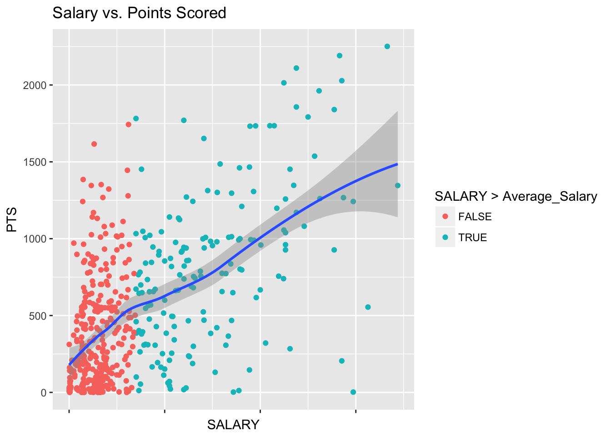
Findings
Do players score better if they are paid more?
Kind of linear
Many players not scoring many points, but still earning high salaries?

Slide 12
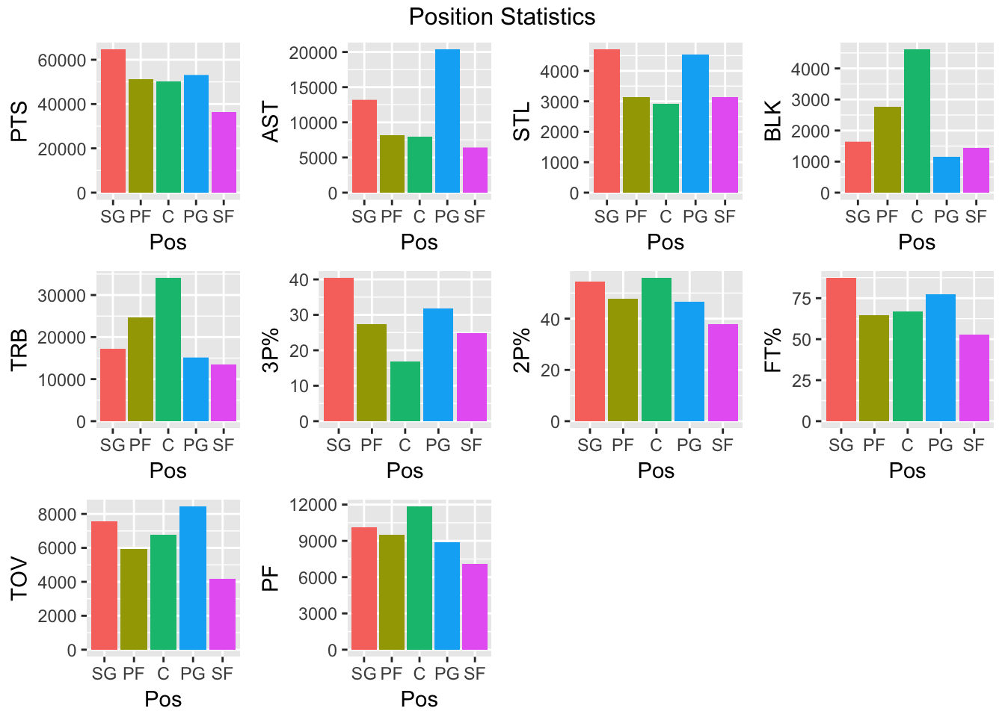
Findings
Which statistics does each position perform the best with?

Slide 13
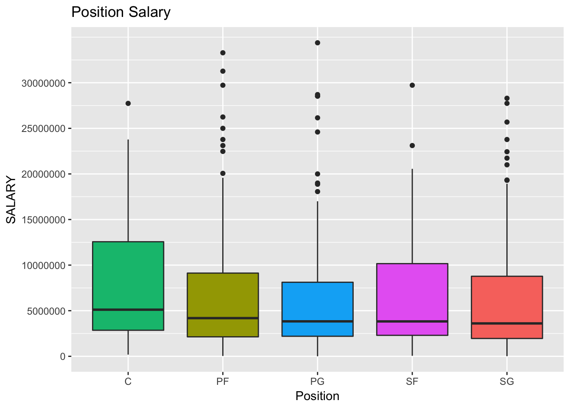
Findings
Which positions get paid the most in the NBA?
PGs get paid the least
Cs get paid the most – why?

Slide 14
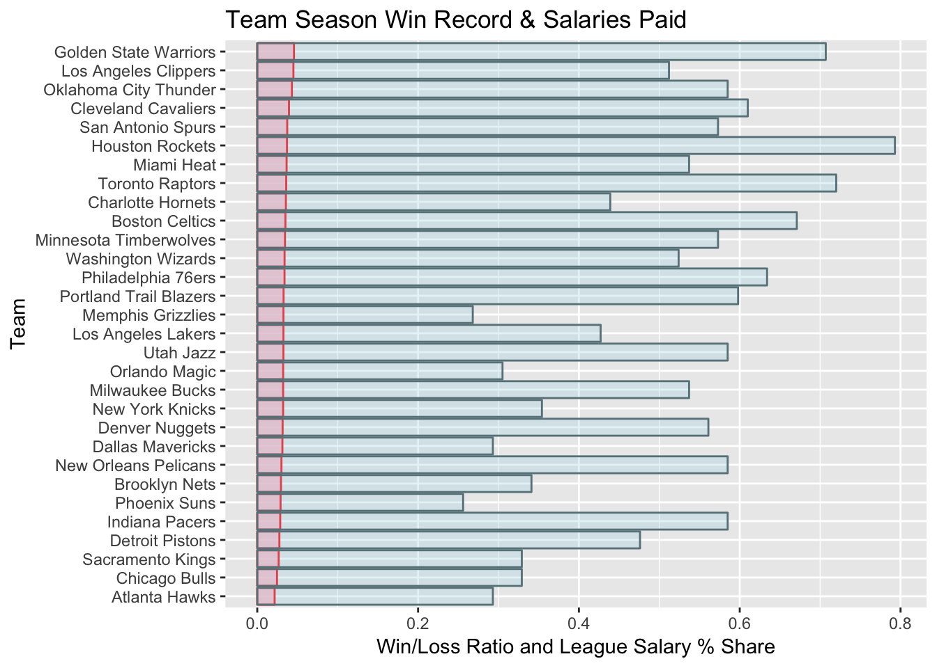
Findings
Do teams play better if they pay higher salaries?

Slide 15
Conclusion
We have made some surprising and some not so surprising observations about the factors affecting a player and team’s performance and salary, but it is clear that our analyses have raised even more questions that cannot be explained by the data that we have seen so far.
In the future, we hope to perhaps analyse the effect of external factors on performance and salary, like the impact of a coach, a player’s social media presence or even the impact of a player management agency.

